Slide 1
WATER SUPPLY SYSTEM
THERMOLINE SYSTEM

Slide 2
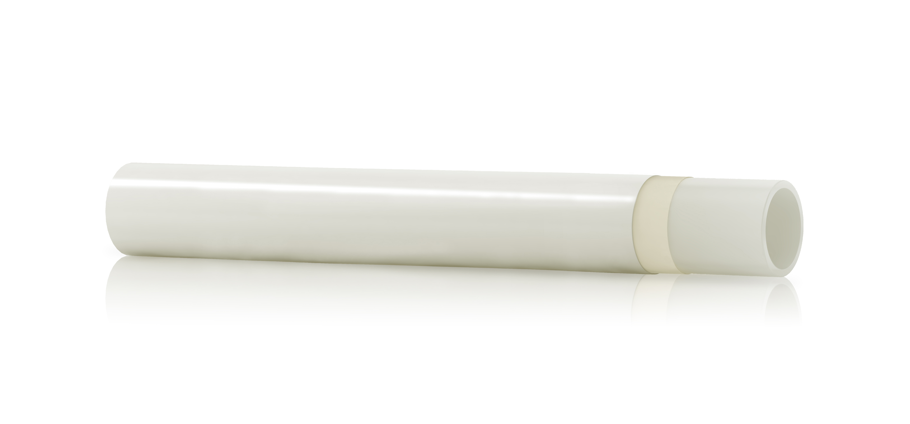
THERMOLINE with oxygen barrier
Thermoline is a plastic pipe produced with crosslinked polyethylene, available with oxygen barrier:
Binding layer
Made up of a strong adhesive that binds EVOH and PE-Xb layers
External layer (oxygen barrier)
EVOH (Ethylene vinyl alcohol)
Internal layer
Made of PE-X (crosslinked polyethylene)

Slide 3
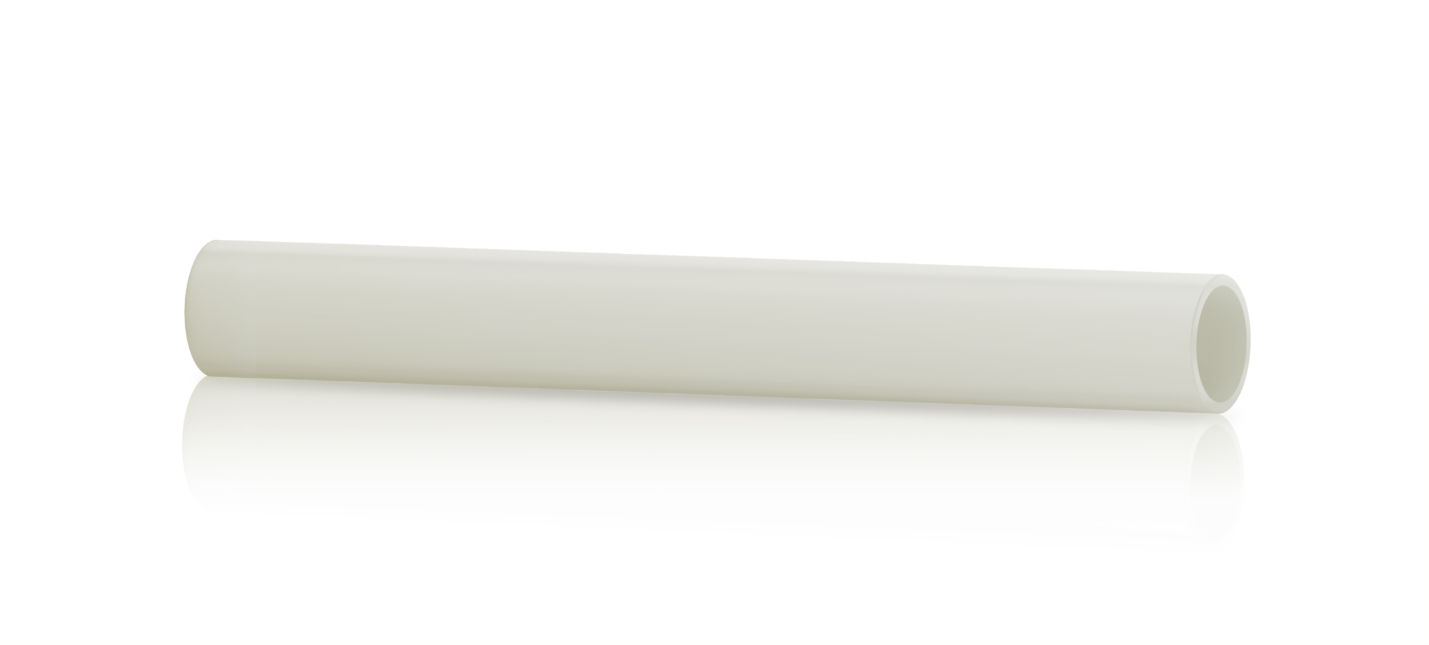
THERMOLINE with oxygen barrier
And without oxygen barrier:
Made of PE-X (Crosslinked Polyethylene)

Slide 4
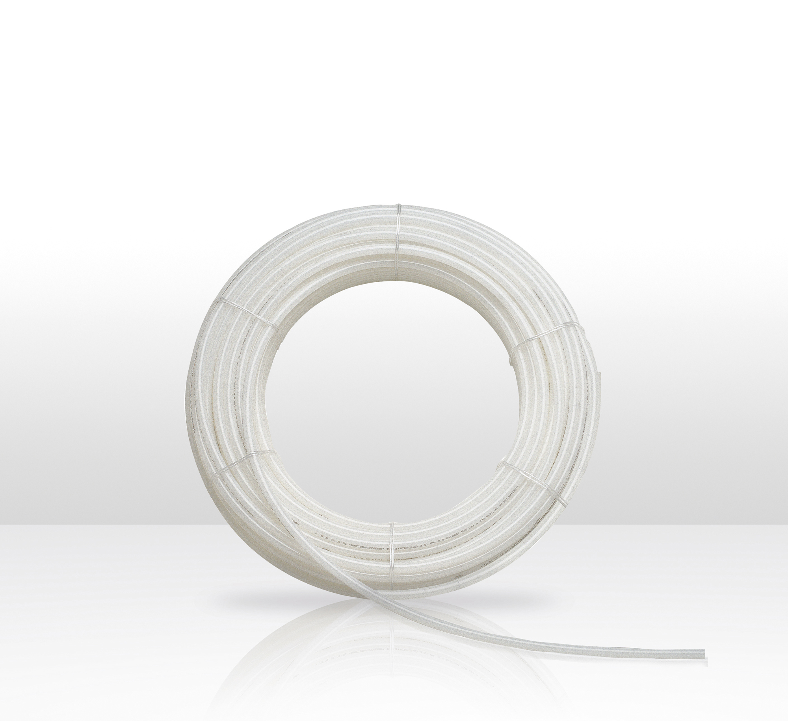
CHARACTERISTICS
Resistance to corrosion.
Resistance to abrasion.
Flexibility.
Lightweight.
Thermal memory (not avaible on pipes with oxygen barrier).

Slide 5
CHARACTERISTICS
Resistance at low temperatures.
Durability.
Acoustic insulation.
Thermal Conductivity.
Ecology.

Slide 6
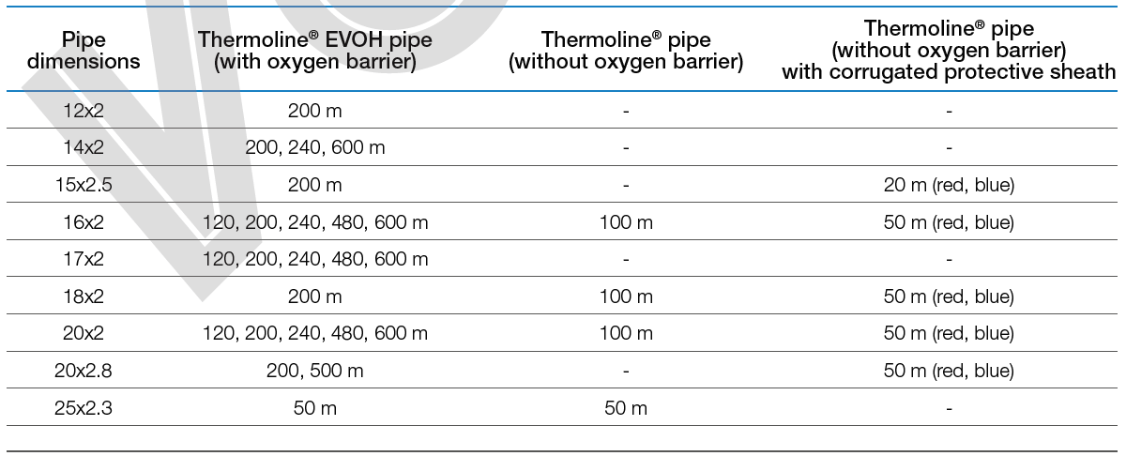
THERMOLINE product range
THERMOLINE pipes are available from 12 to 25 mm, also with corrugated protective sheath.

Slide 7
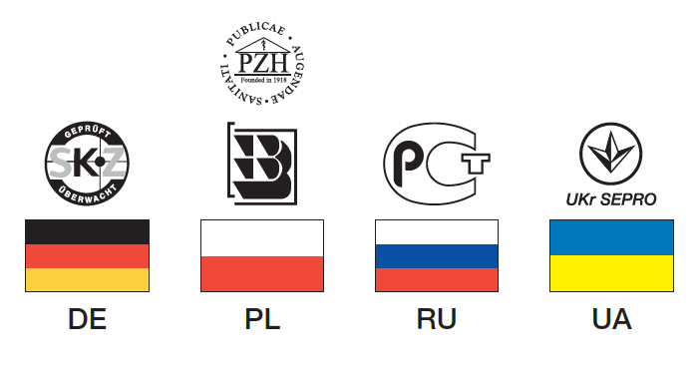
certifications
THERMOLINE is manufactured in accordance to international standard ISO 15875 and certified by the strictest certification bodies:

Slide 8
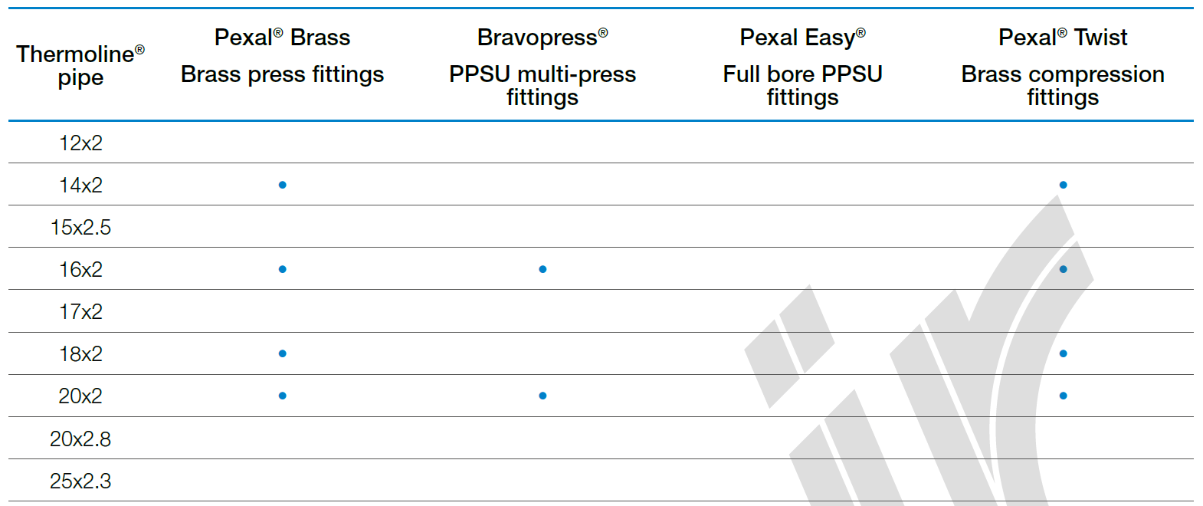
Valsir fittings range
The following fittings are available:

Slide 9
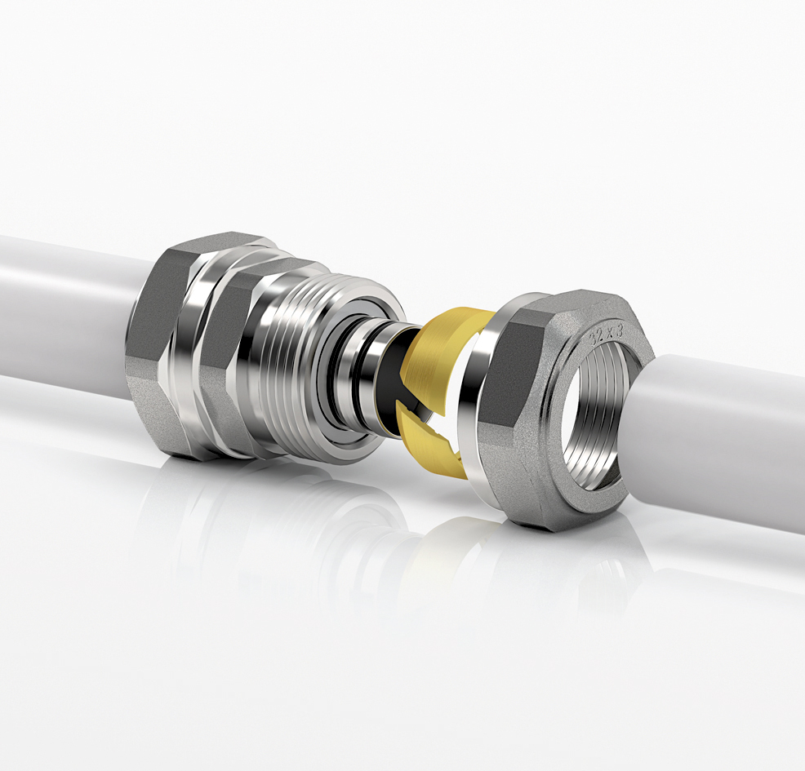
PEXAL TWIST
ADVANTAGES
Easy to install
Reusable fitting
No special tools required

Slide 10
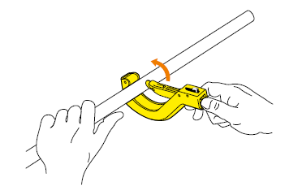
PEXAL TWIST
Cut the pipe

Slide 11
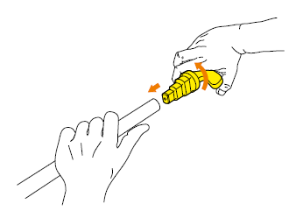
PEXAL TWIST
Cut
Ream

Slide 12
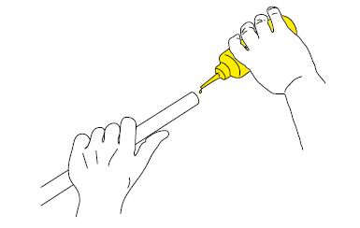
Pexal twist
Cut
Ream
Lubricate

Slide 13
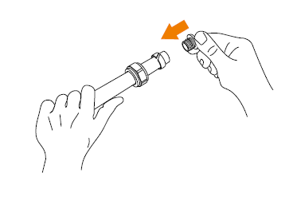
Pexal twist
Cut
Ream
Lubricate
Insert nut and olive and tail

Slide 14
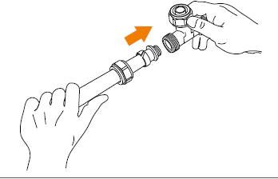
Pexal twist
Cut
Ream
Lubricate
Insert nut and olive and tail
Insert the fitting

Slide 15
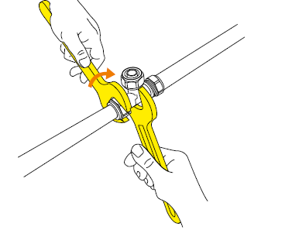
Pexal twist
Cut
Ream
Lubricate
Insert nut and olive and tail
Insert the the fitting
Tighten the nut

Slide 16
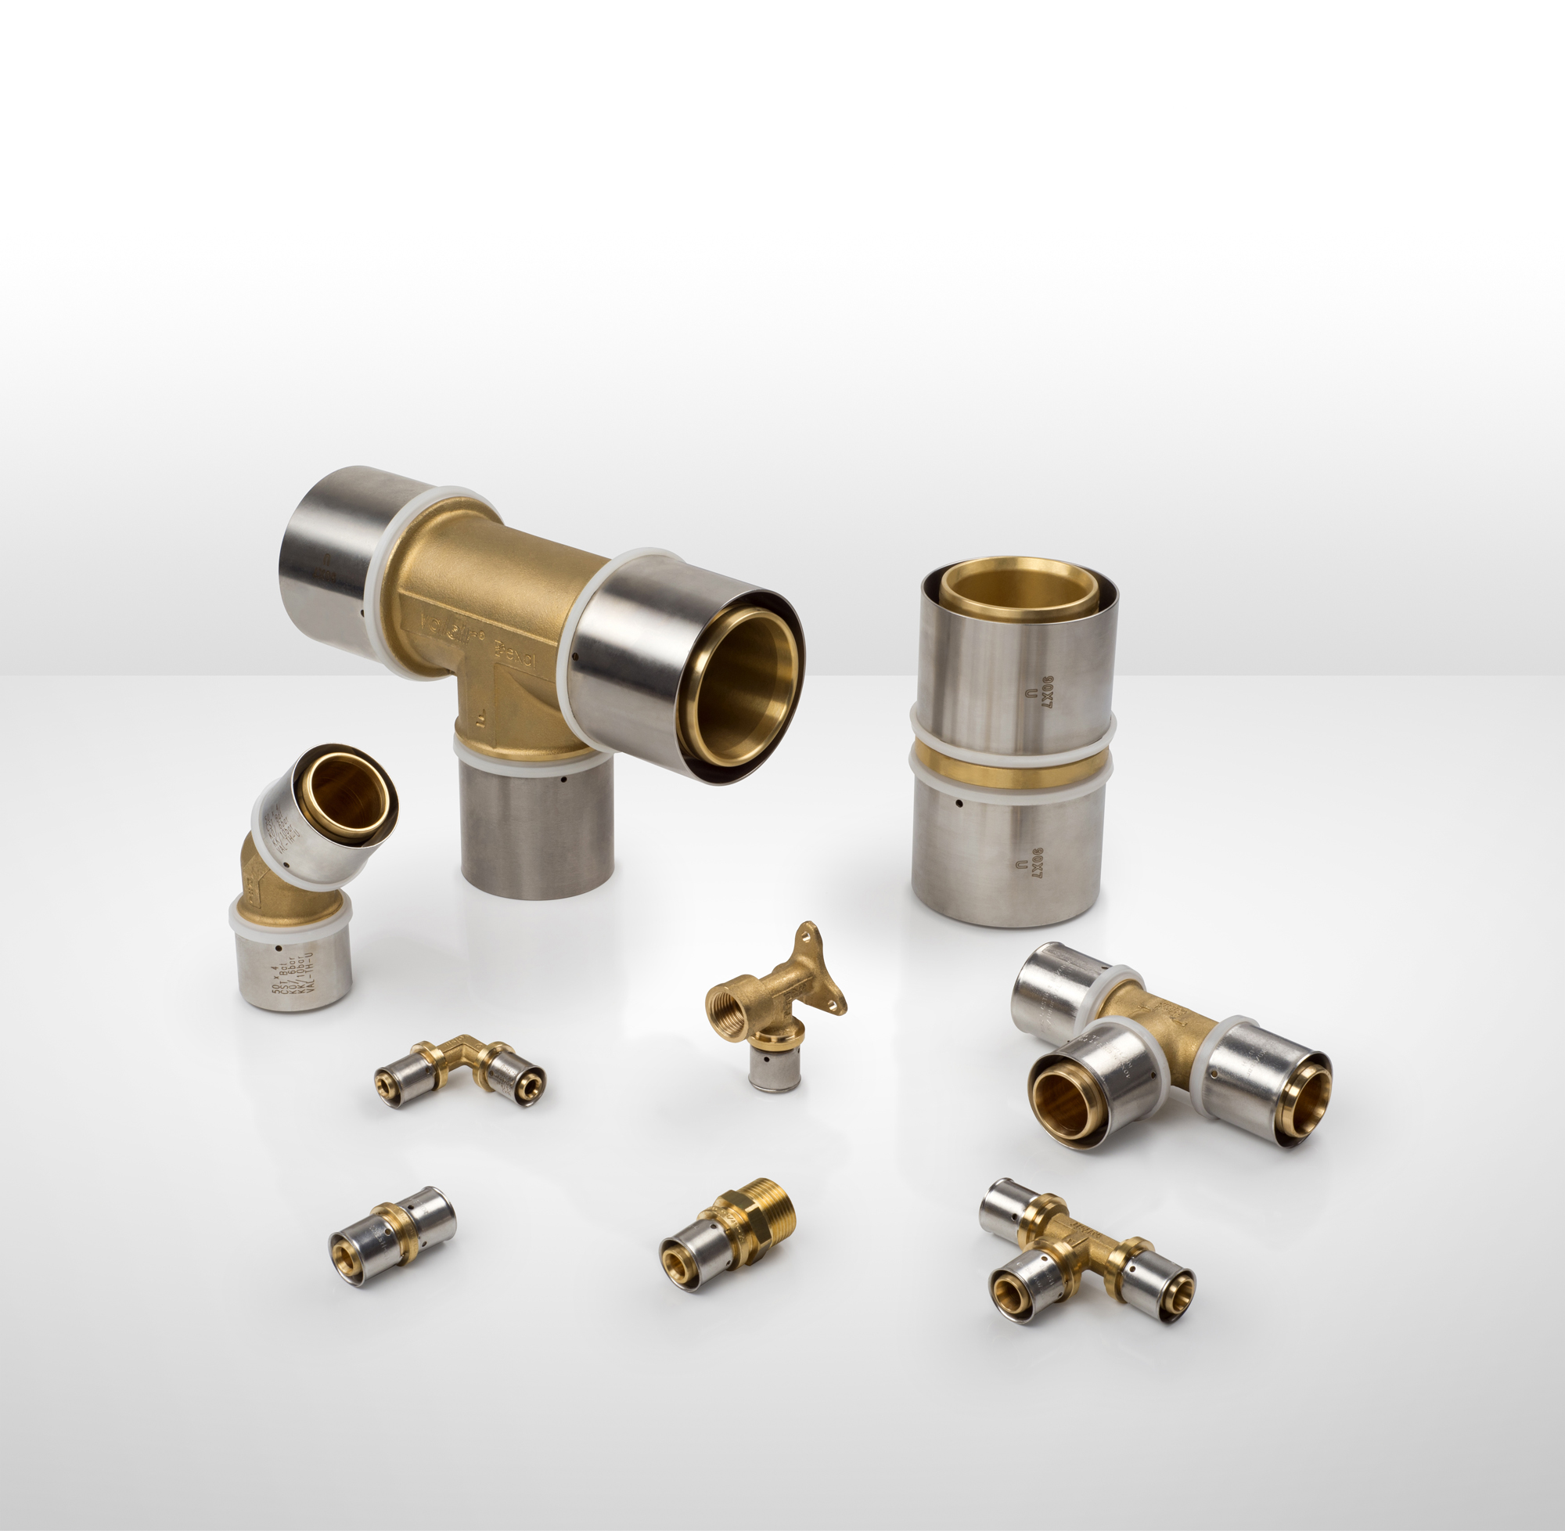
Pexal brass
ADVANTAGES
Fast installation
Safety of installation
Complete range of fittings
Brass body
Multi-crimping
Leak free
New sleeve fastener
Notes:
L’accoppiamento avviene mediante compressione o del tubo o di una boccola posta sul raccordo che viene schiacciata mediante un’apposita ganascia azionata da una macchina o pinza pressatrice. Il portagomma è anti sfilamento e vengono compressi gli OR di tenuta.

Slide 17
PEXAL BRASS
Cut

Slide 18
PEXAL BRASS
Cut
Ream

Slide 19
PEXAL BRASS
Cut
Ream
Lubricate

Slide 20
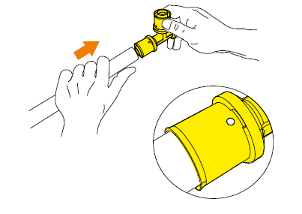
PEXAL BRASS
Cut
Ream
Lubricate
Insert the fitting

Slide 21
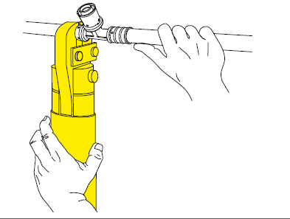
PEXAL BRASS
Cut
Ream
Lubricate
Insert the fitting
Crimp the sleeve

Slide 22
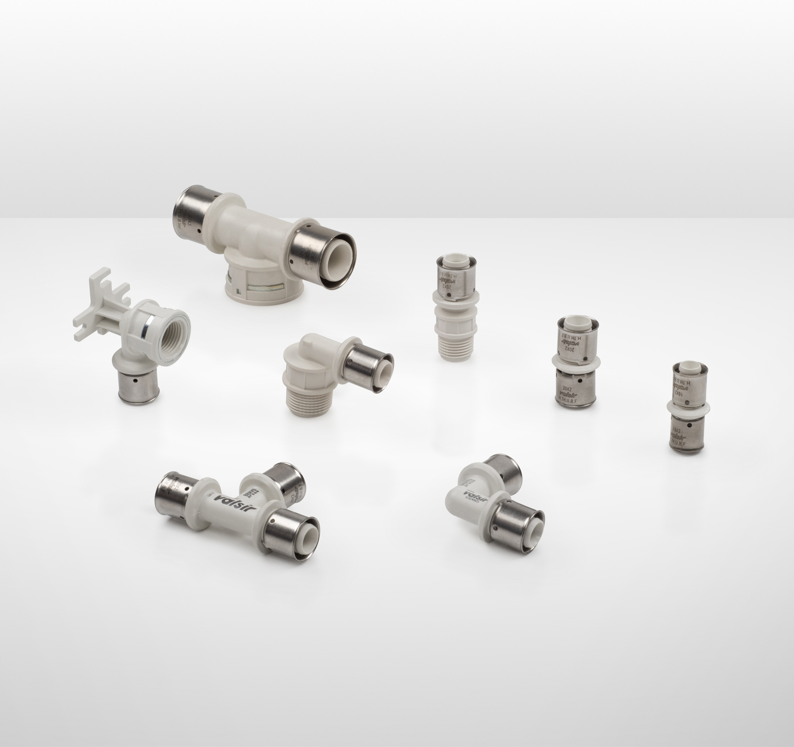
BRAVOPRESS
ADVANTAGES
Lightness
High resistance to chemicals, especially chlorine
Easy to install
Multi-crimping profile
Leak free

